Slide 1

HOTEL Management System
Fuat Yiğit Koçyiğit – 16429085948
Eyüp Bahadır Başlı – 56821253002
Hüseyin Berk Bulut – 52945278204
Fatih Mehmet Yiğitel – 38651154902

Slide 2
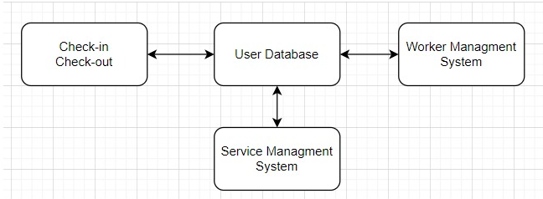
High Level Architecture
Hotel Management System uses «Repository Pattern»
Hotel has a main database

Slide 3
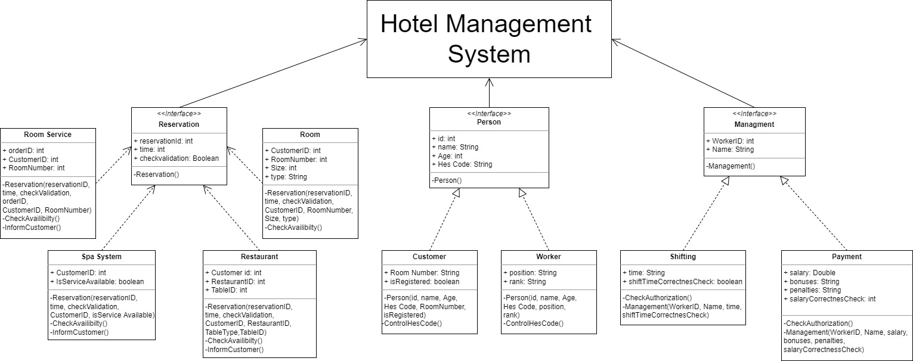
UML Diagram

Slide 4

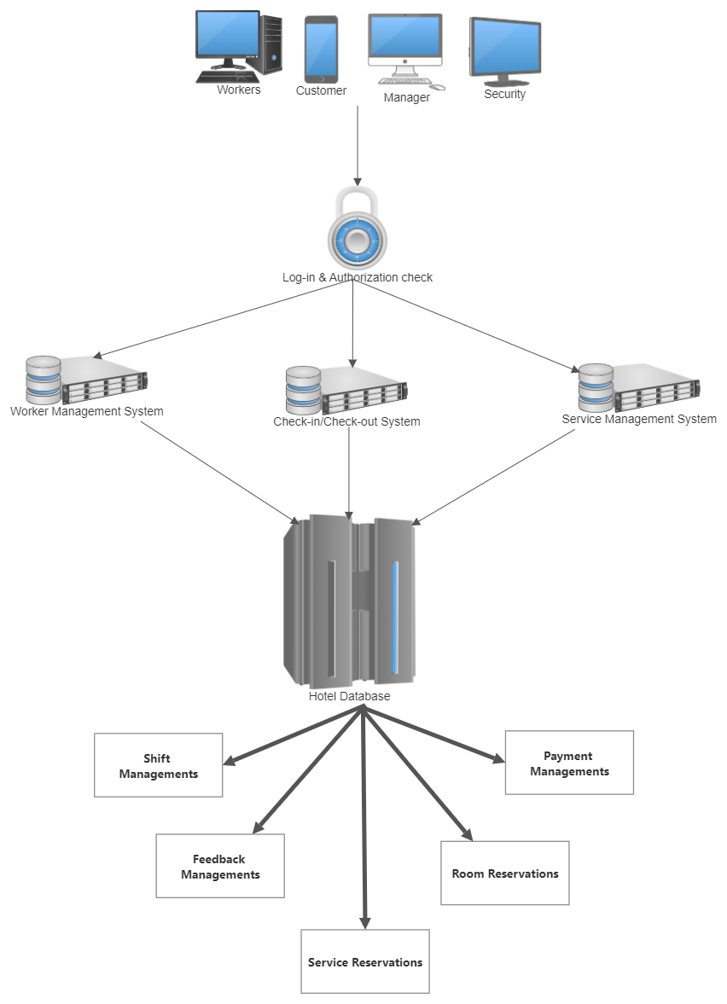
Physical View of the Project

Slide 5
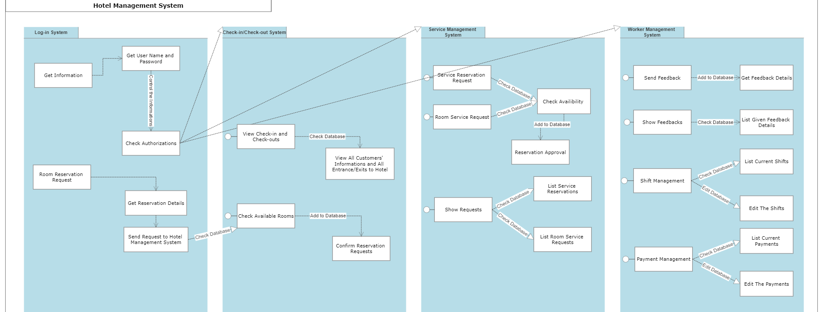
Logical View of the Project

Slide 6
Log-in System «Factory Method Pattern»
Person Class
Worker Class
Customer Class

Slide 7
Room Reservation «Builder Pattern»
Room Class
Reservation Class

Slide 8
Management System «Factory Method Pattern»
Payment Class
Shifting Class

Slide 9
Restruant/Room Service/Spa Reservation System «Observer Pattern»
Room Service System Class
Restraunant Class
Spa System Class

Slide 10

Used Technologies
IDE: Microsoft Visual Studio
Programming Language: C#
Database System: Mssql
Windows Form

Slide 11


